Slide 1
Introduction to
Dictionary – Data Structure

Slide 2

Why do we use Dictionary?
Efficient data retrieval based on keys.
Mapping of keys to values for organizing data.
Flexibility to store values of different data types.
Support for adding, modifying, and removing key-value pairs.
Enforced uniqueness of keys for data integrity.
Commonly used for configuration settings and data storage.
Transformation of data from one format to another.
Caching and memorization for performance optimization.
Fundamental for implementing hash tables and efficient data structures.
Versatile and invaluable for various programming tasks.

Slide 3
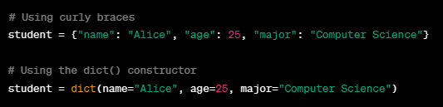
Dictionary Creation
In Python, dictionaries are created using curly braces {} or the dict() constructor. They consist of key-value pairs separated by colons. Here's how you create a dictionary:
Example:

Slide 4
Explaining Dictionary
Keys Are Immutable: Keys in a dictionary must be of an immutable data type, such as strings, numbers, or tuples. Lists and other dictionaries cannot be used as keys because they are mutable.
Values are Mutable: Dictionaries are mutable, meaning you can add, modify, or delete key-value pairs after creation.

Slide 5
Explaining Dictionary
Comprehension: You can use dictionary comprehensions to create dictionaries from iterable using concise and expressive syntax.
key_expression: This is an expression that defines how each element in the iterable should be used as a key in the resulting dictionary.
value_expression: This expression specifies how each element in the iterable should be used as a value in the resulting dictionary.
element: This variable represents each element in the iterable as you iterate through it.
iterable: The iterable is the source of data from which you create the dictionary. It can be any iterable, such as a list, tuple, or range.

Slide 6

Dictionary Comprehension
Here's an example of a dictionary comprehension that creates a dictionary of squares for numbers from 1 to 5:
x is the element from the range(1, 6) iterable.
x is used as both the key and the value, with the key being x and the value being x**2.

Slide 7
Dictionary Comprehension
Here's an example that uses a conditional expression to create a dictionary of even numbers and their squares:
x is the element from the range(1, 11) iterable.
The dictionary comprehension includes a conditional (if x % 2 == 0) to filter for even numbers only.
The key is x, and the value is x**2.
The resulting even_squares dictionary will contain only the squares of even numbers:

Slide 8
Dictionary Concatenation
Concatenation: This operation merges the key-value pairs from multiple dictionaries into a new dictionary, creating a larger dictionary that contains all the data from the original dictionaries.
There are many ways for concatenating two or more dictionaries.

Slide 9
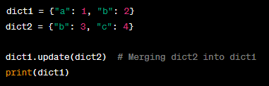

Dictionary Concatenation
Using the update() Method:
Output:

Slide 10
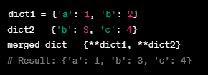
Dictionary Concatenation
Merging Dictionaries: You can use the double asterisk ** operator to unpack a dictionary into another dictionary, effectively merging them. For example:

Slide 11
Accessing Values in Dictionary:
Square Bracket Notation: You can access a value by specifying the key inside square brackets [] after the dictionary variable.

Slide 12
Accessing Values in Dictionary:
get() Method: The get() method allows you to retrieve a value by providing the key as an argument. It also allows you to set a default value in case the key is not found.

Slide 13

Accessing Values in Dictionary:
Keys() Method: You can use the keys() method to get a list of all the keys in the dictionary, and then iterate through the keys to access their corresponding values.

Slide 14

Accessing Values in Dictionary:
Items() Method: The items() method returns a list of key-value pairs as tuples. You can iterate through these pairs to access both keys and values.

Slide 15

Updating Values in Dictionary:
Direct Assignment: You can update a dictionary by directly assigning a new value to a specific key or adding a new key-value pair.

Slide 16

Deleting Values in Dictionary:
Using the pop() Method: The pop() method allows you to remove a specific key-value pair from the dictionary and returns the value associated with the removed key.

Slide 17


Deleting Values in Dictionary:
Using the del Statement: You can use the del statement to remove a specific key from the dictionary.
Using the clear() Method: The clear() method removes all key-value pairs from the dictionary, effectively clearing it.

Slide 18
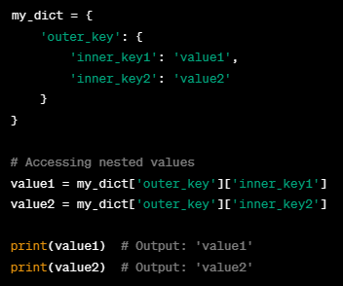
Nested Indexing: Dictionary
Example:

Slide 19
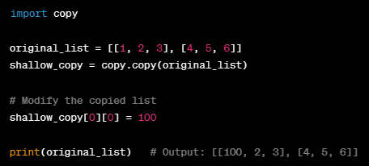
Deep & Shallow Copy
Shallow Copy Example:

Slide 20
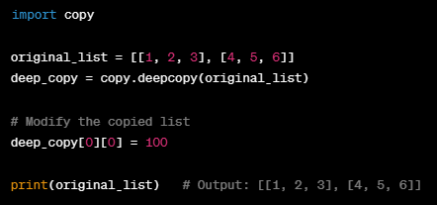
Deep & Shallow Copy
Deep Copy Example:

Slide 21
Dictionary Functions:
.keys() returns a list of keys.
.values() returns a list of values.
.items() returns a list of key-value pairs (tuples).
del my_dict['key'] removes a key-value pair.
.pop('key') removes and returns the value.
.popitem() removes and returns a random key-value pair.
.clear() removes all items in the dictionary.
Use my_dict.copy() or dict(my_dict) for shallow copies.

Slide 22
Assignment09: Dictionary
Build an Address Book
Requirements:
Implement an address book using a dictionary.
Allow users to perform the following operations:
Add a new contact (name, phone number, address).
Display all contacts in the address book.
Quit the program.

